Slide 1
Macro Lecture 2: Aggregate Demand and Aggregate Supply
In macroeconomics, the focus is on the demand and supply of all goods and services produced by an economy. Accordingly, the demand for all individual goods and services is also combined and referred to as aggregate demand.
The supply of all individual goods and services is also combined and referred to as aggregate supply. Like the demand and supply for individual goods and services, the aggregate demand and aggregate supply for an economy can be represented by a schedule, a curve, or by an algebraic equation
AD= C+I+G+(X-M)

Slide 2
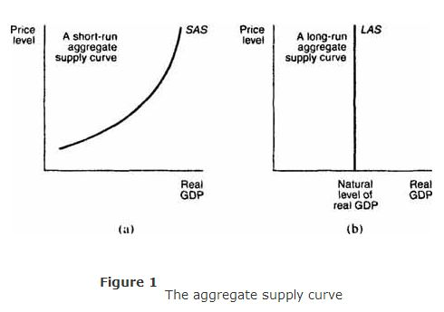
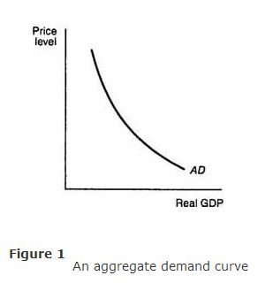
AD and AS curves

Slide 3
Reasons for a downward‐sloping aggregate demand curve. Three reasons cause the aggregate demand curve to be downward sloping. The first is the wealth effect. The aggregate demand curve is drawn under the assumption that the government holds the supply of money constant. One can think of the supply of money as representing the economy's wealth at any moment in time. As the price level rises, the wealth of the economy, as measured by the supply of money, declines in value because the purchasing power of money falls. As buyers become poorer, they reduce their purchases of all goods and services. On the other hand, as the price level falls, the purchasing power of money rises. Buyers become wealthier and are able to purchase more goods and services than before. The wealth effect, therefore, provides one reason for the inverse relationship between the price level and real GDP that is reflected in the downward‐sloping demand curve.

Slide 4
Changes in aggregate demand
Changes in aggregate demand are represented by shifts of the aggregate demand curve. An illustration of the two ways in which the aggregate demand curve can shift is provided in Figure .
A shift to the right of the aggregate demand curve. from AD ₁ to AD ₂, means that at the same price levels the quantity demanded of real GDP has increased. A shift to the left of the aggregate demand curve, from AD ₁ to AD ₃, means that at the same price levels the quantity demanded of real GDP has decreased.

Slide 5
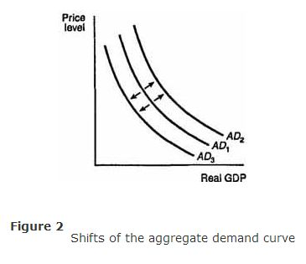

Slide 6
Changes in aggregate supply.
Changes in aggregate supply are represented by shifts of the aggregate supply curve. An illustration of the ways in which the SAS and LAS curves can shift is provided in Figures (a) and (b). A shift to the right of the SAS curve from SAS ¹ to SAS ² of the LAS curve from LAS ¹ to LAS ² means that at the same price levels the quantity supplied of real GDP has increased. A shift to the left of the SAS curve from SAS ¹ to SAS ³ or of the LAS curve from LAS ¹ to LAS ³ means that at the same price levels the quantity supplied of real GDP has decreased .

Slide 7
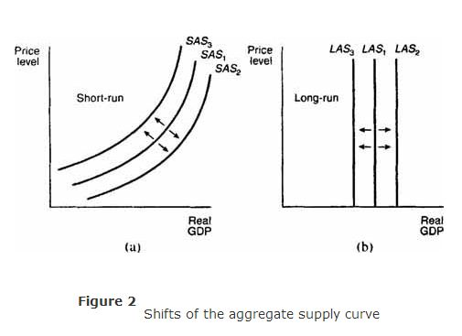

Slide 8
Combining AD and AS Supply Curves
When the aggregate demand and SAS (short-run aggregate supply) curves are combined, as in Figure , the intersection of the two curves determines both the equilibrium price level, denoted by P *, and the equilibrium level of real GDP, denoted by Y * .

Slide 9
